Slide 1
Microsoft word and madcap flare
Tools and Technologies for Tech Writers 2022
Julio Madrid

Slide 2
Agenda
Introduction to Microsoft Word
Microsoft Word: Strengths and Weaknesses
Multi-channel Publishing Shortcomings
Introduction to MadCap Flare
MadCap Flare: Strengths and Weaknesses
Single Sourcing
MadCap Flare Workflow
Conclusions

Slide 3
Introduction to Microsoft Word
Microsoft Word is a popular commercial word processing software designed by Microsoft.
Word initially launched in 1983.
WYSIWYG

Slide 4
Microsoft Word: Strengths and weaknesses
Strengths
Weaknesses
Accessible
Anyone can create content almost immediately.
Ubiquitous
Available almost everywhere.
More likely to receive help from others.
Limited
Not great for large documents or projects.
Not Reusable
Changes to specific content are not applied to the same content elsewhere.

Slide 5
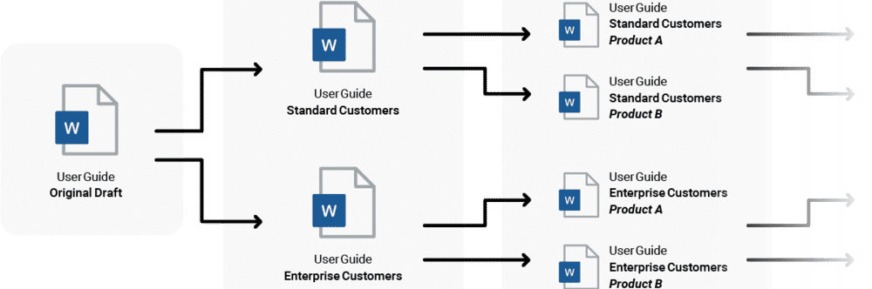
MulTi-Channel Publishing Shortcomings
In Word, content authors make changes to specific content manually for different audiences. Creating many derivatives like this is an inefficient way to work.

Slide 6
Introduction to MadCap Flare
MadCap Flare is a content management application used to create, manage, and publish content in a variety of formats and devices.
Flare is an authoring tool more commonly used by technical writers and documentation specialists.

Slide 7
MadCap Flare: Strengths and Weaknesses
Strengths
Weaknesses
Flexible
XML structure bars, drag-and-drop capabilities.
Reusable
Single-sourcing, multi-channel publishing, content reuse, topics, conditions, variables, snippets, and more.
Alternative to Microsoft Word
MadCap Flare is a more effective tool for technical documentation.
Overwhelming
There are so many features it can be difficult to locate what you need.
Unstable
It is prone to crashes.

Slide 8
Single Sourcing
Single sourcing is the practice of reusing content throughout a documentation deliverable.
Single source workflow: master source files to generating outputs.
Single sourcing features include conditions, snippets, targets, topics, variables, and more.
Advantages: decreases authoring time and reduces likelihood for error.

Slide 9
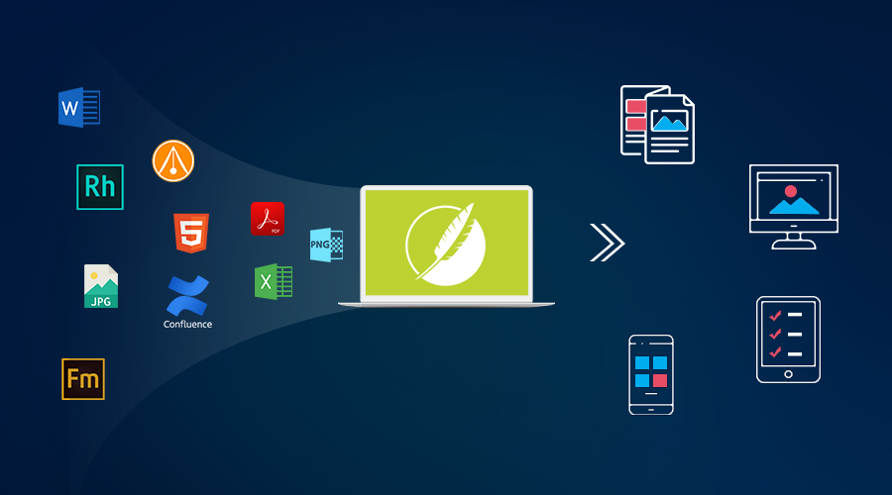
MADcAP Flare Workflow
MadCap Flare can import content from different sources like Excel, PDF, HTML5, FrameMaker, and Word. MadCap Flare can then publish content in a variety of formats and devices.

Slide 10
Conclusions
Technical documentation should be repeatable and automatable. These priorities are not met by a word processor like Microsoft Word.
Microsoft Word has certain strengths, but it is not designed for complex documents and projects.
A publishing tool like MadCap Flare has flexible and reusable features that make it a strong alternative to Word.

Slide 11
Contact Information
E-mail: juliomadrid626@gmail.com
LinkedIn: https://www.linkedin.com/in/jmadrid91/

